Slide 1
Data representation
data

Slide 2
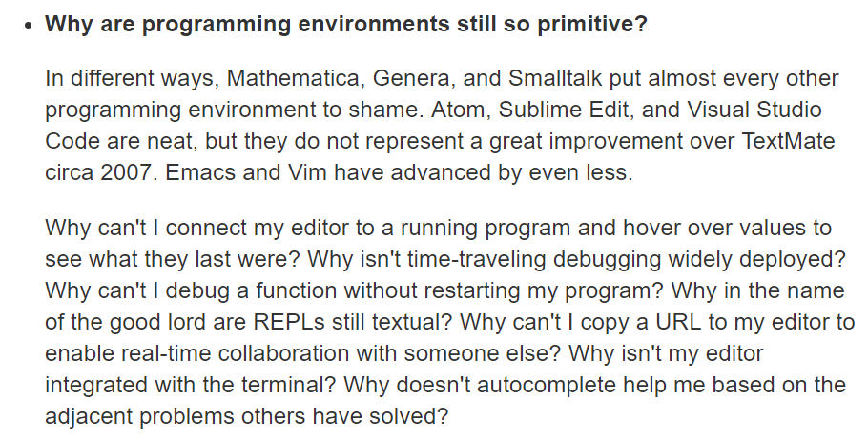
In the news
Read–Eval–Print Loop

Slide 3
Last week
Boolean logic
AND
OR
NOT
NAND

Slide 4
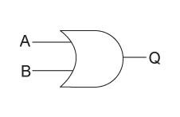
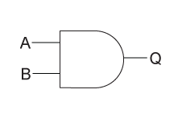
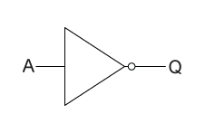
Or
and

Slide 5
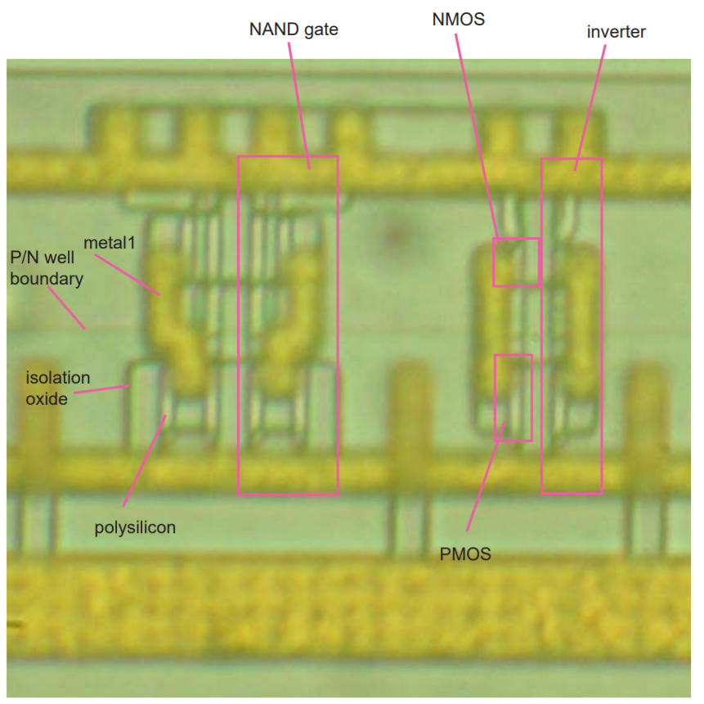
Why learn this?

Slide 6
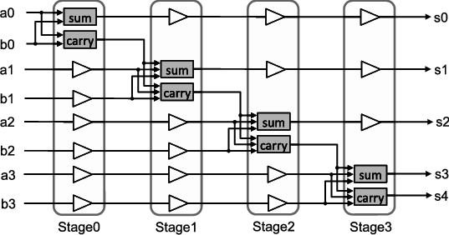
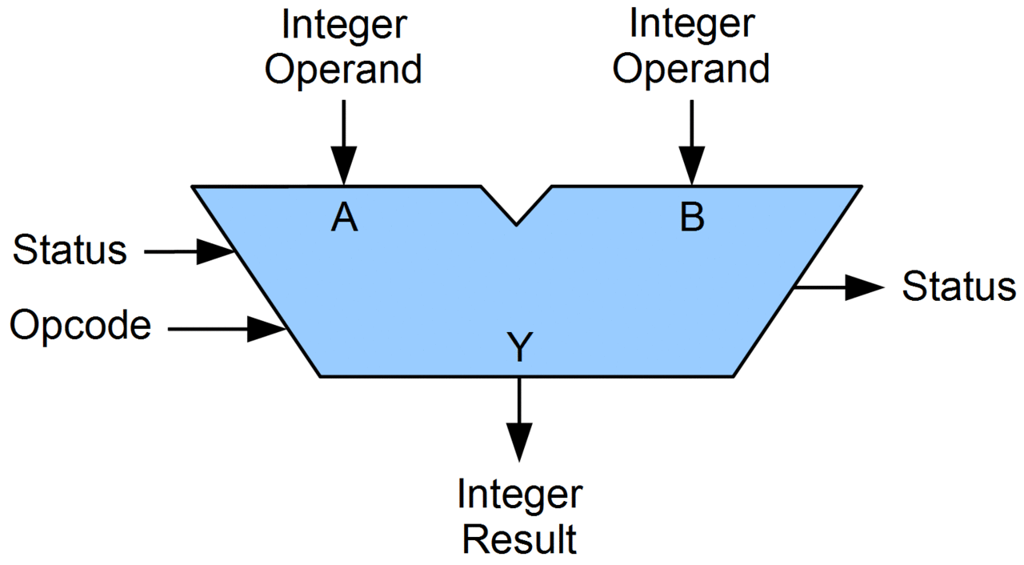

Slide 7
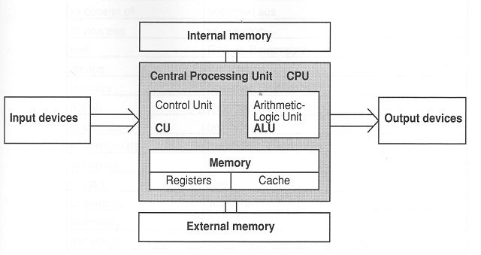

Slide 8
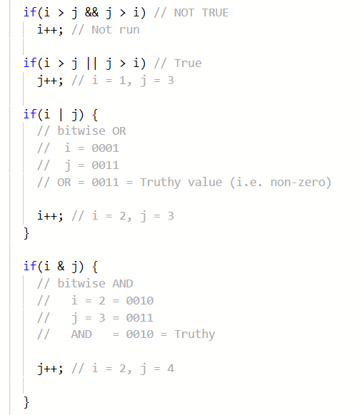
C++
4 bit
8 bit
Boolean logic

Slide 9
Cpu and memory
Memory is the area where the computer stores or remembers data
Memory provides the CPU with its instructions
Memory is either volatile or non-volatile
Volatile memory only stores information to run programs while the computer is on. It is reset and emptied once the computer is turned off. Volatile memory requires electricity to store data using transistors and capacitors.
Binary

Slide 10
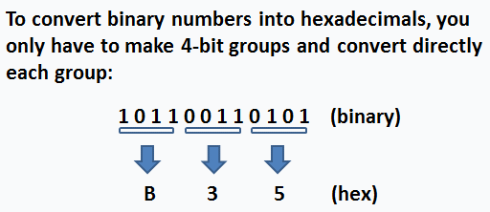
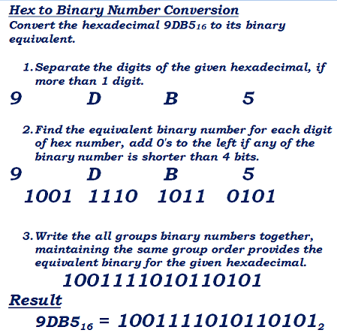

Slide 11
numbers
Binary, base 2
HEX, base 16
OCT, base 8

Slide 12
text
To store text each character is given a binary code.
There are different ways of encoding the characters – one way is using the ASCII code.
ASCII stands for American Standard Code for Information Interchange.
ASCII uses one byte to represent each letter.
The letter A would convert to 01000001, while a would be 01100001

Slide 13
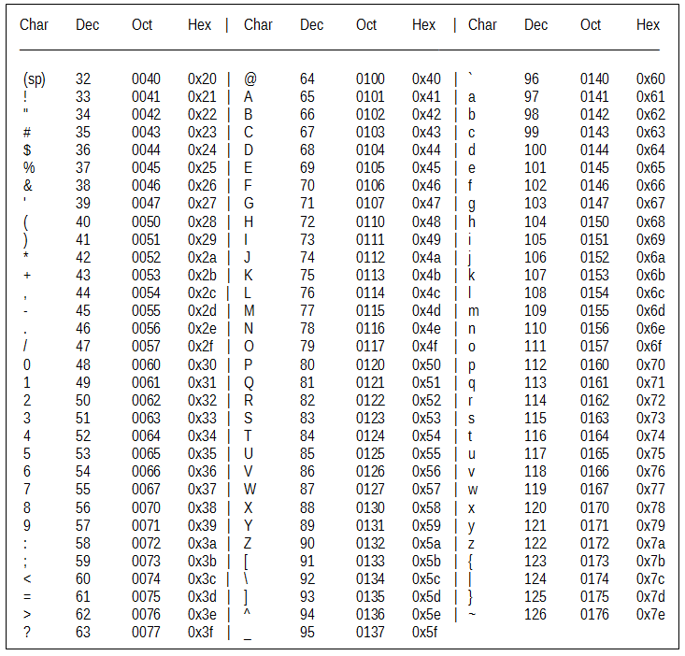

Slide 14
Data representation Research task
Research and document, with examples the following:
HEX, how to convert to and from both denary and binary
OCT, how to convert to and from both denary and binary
ASCII, history and use
Unicode, history and use (google: joel on software Unicode)

Slide 15
Extension
Bitmap
Gif
Jpg
Html, js, css
MySQL database

